Slide 1
PC Maintenance: Preparing for A+ Certification
Chapter 29: Managing Files

Slide 2
Chapter 29 Objectives
Understand and identify file systems
Manage files under Windows
Display and close a command prompt
Manage files via command prompt

Slide 3
File System
A logical method of storing on a disk
Determines what identifiers mark the beginning and end of a file
Determines what information will be stored about the file

Slide 4
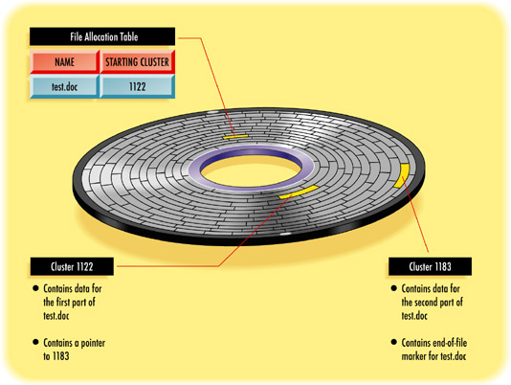
How File Systems Store Data

Slide 5
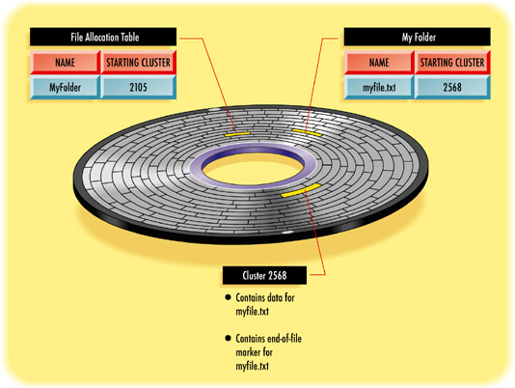
How File Systems Store Data

Slide 6
File Systems on DOS and Windows PCs
FAT (FAT16)
  16-bit file system
  Up to 2 GB of data per logical drive
FAT32
  32-bit file system
  Otherwise fairly similar to FAT16
FAT12
  File system used on floppy disks
  Each 512-byte sector is its own cluster

Slide 7
File Systems on DOS and Windows PCs
NTFS 4
  32-bit file system
  Used only in Windows NT 4
  Predates FAT32
  Ability to create a spanned disk
NTFS 5
  Updated NTFS for Windows 2000/XP
  File encryption, disk quotas, dynamic disks

Slide 8
File Systems on DOS and Windows PCs
CDFS
  CD file system, used on CDs
HPFS
  High Performance File System
  Native file system for OS/2

Slide 9
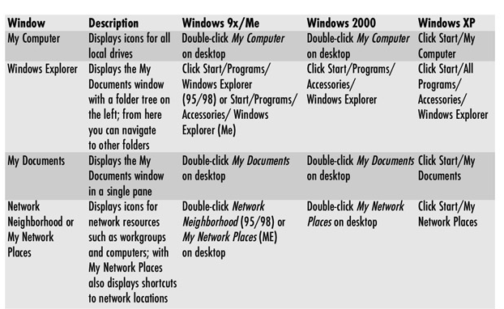
Using Windows File Management

Slide 10
File Management Skills to Master
Select
Copy
Move
Delete
Rename
View/change properties
Create/delete folders
Work with Recycle Bin

Slide 11
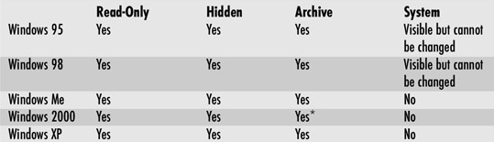
File Attributes

Slide 12
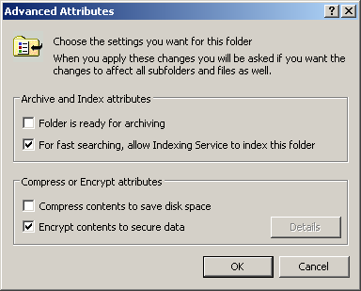
NTFS File Attributes
Compression
Encryption
On NTFS volumes only
Encryption available in NTFS 5 only

Slide 13
Troubleshooting File Errors
General failure reading drive X
  Disk is not formatted
  Disk has gone bad
  Drive is inaccessible
  Possible virus infection
  Possible physical problem

Slide 14
Troubleshooting File Errors
Data error reading (or writing) drive x
  Physically bad spot on the disk
  Wrong drive type in BIOS setup
Access denied
  Permission setting preventing file modification
  Disk is write-protected
Insufficient disk space
  Disk is full
  Directory is full

Slide 15
Backing Up and Restoring Files
Copy files to another drive manually
  Hard drive
  CD
  Tape
Copy an entire drive
  Ghosting
Backup application (ex. Microsoft Backup)

Slide 16
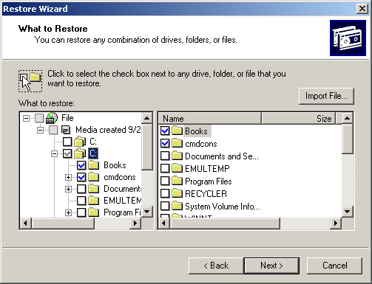
Microsoft Backup
Different versions of Windows have different versions of Backup

Slide 17
Working with a Command Prompt
Getting to the prompt:
  Boot from a Windows 9x startup floppy
  Start/Run, Command in 9x
  Start/Run, Cmd in 2000/XP
Exiting the prompt
  Close the window
  Type EXIT and press Enter

Slide 18
Changing Drives and Directories
Directory = Folder
Change drive: Type drive letter and a colon
  Example: C:
Change directory: CD and the directory name
  Example: CD \WINDOWS

Slide 19
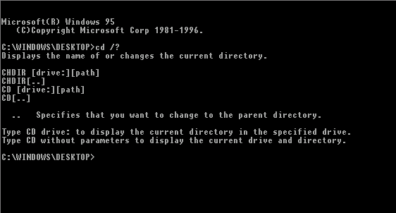
Command Syntax Help
Add the /? switch to a command to see its syntax

Slide 20
Understanding Wildcards
? for single character
* for any number of characters
File spec | Includes | But does not include
A*.DOC | Amy.doc, Amherst.doc, A.doc | Amy.txt, Betty.doc, Amherst.grp
A???.DOC | Ants.doc, Army.doc, Also.doc | Amy.doc, Amherst.doc, Alls.txt
??D.* | And.txt, And.doc, Atd.xls | All.txt, Anderson.doc
*. | And, Book, Cheers | And.doc, Book.txt, Cheers.xls

Slide 21
Viewing Multiple Pages
/p switch for DIR command
| MORE for most commands
| is the pipe symbol (redirector)

Slide 22
Common Commands
DEL
DELTREE
MD
RD
SETVER
COPY
XCOPY
MEM
PROMPT

